Slide 1



Purpose. Belief. Responsibility.
KNOWLEDGE LEADER WITH THE DNA OF INNOVATION & CUSTOMER SUCCESS

Slide 2


Key Verticals

Slide 3
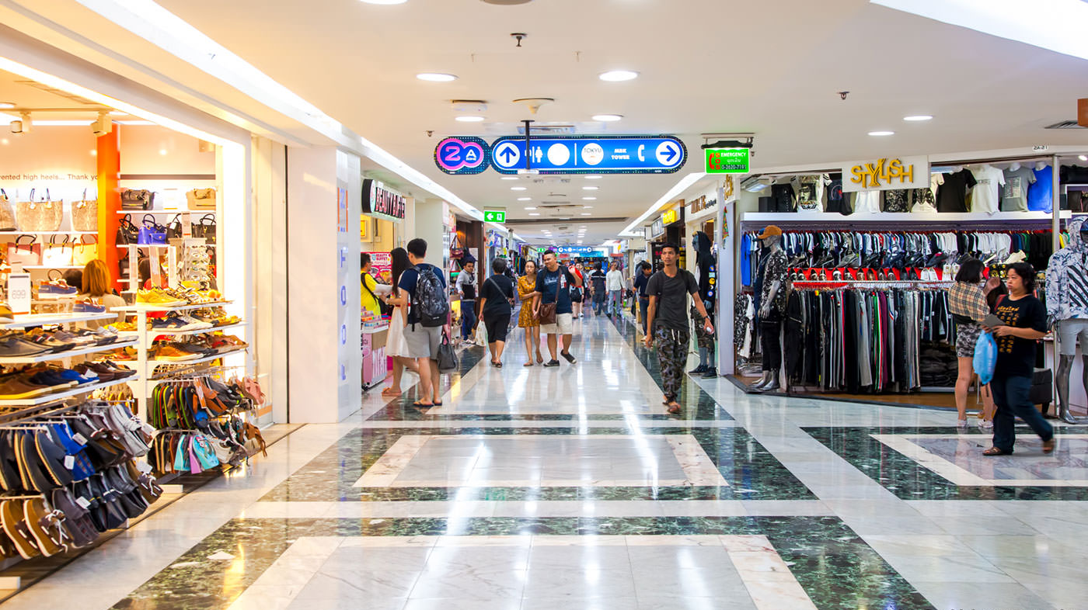
Data science services and what we do in it ?
Advisory services
Data science solution consulting in the areas of predictive and prescriptive analytics
R&D
Proto-type & product development using open stacks
Premium Services
Data visualization & blended insights

Slide 4

FMCG INVENTORY MANAGEMENT USING FORECASTING
Case study-based discussion

Slide 5
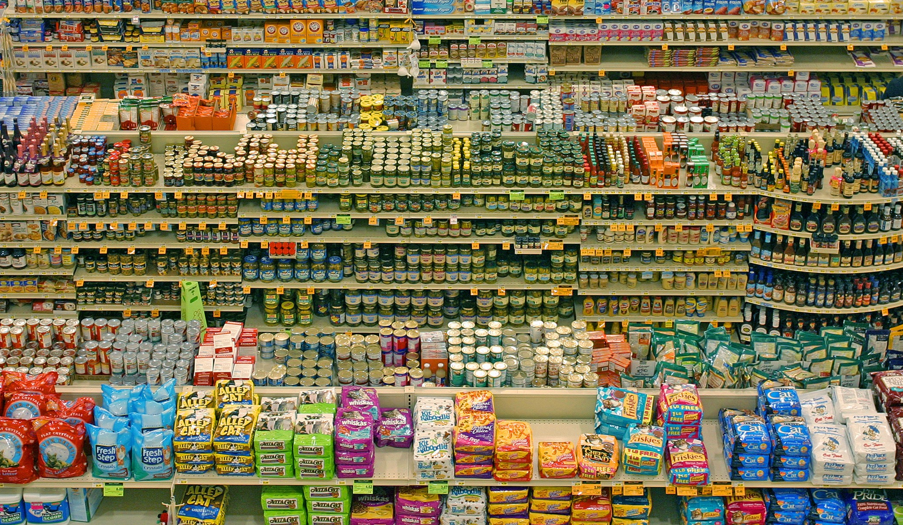
Typical FMCG Business Challenge
As a retailer,
1. How can I decide optimal quantity of different SKU’s at my shelf ?.
2. How can I maintain my customer service levels with optimal inventory ?.
3. How can I decide upon the effects of weather, holiday and macro economic factors on my sales?.

Slide 6

General Expectation from the solution
Reduce firm’s working capital by reducing held inventories.
Understand product demand in market to reduce stock out situations.
Localized pattern cognizance.

Slide 7
Model Selection basis
Demand
Trend
Season
Events
Sales promotions
Festivals
Causal variables
Product prices
Advertisement expense
Randomness
Holidays
Macro economic factors

Slide 8
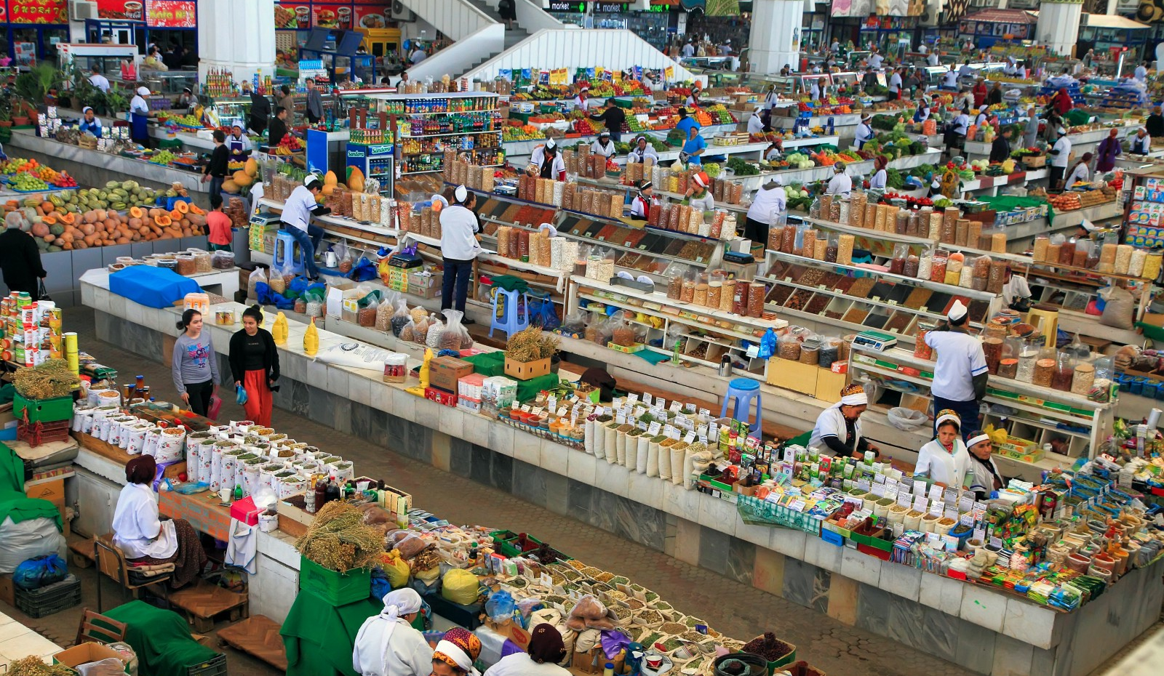
Formalize forecast framework for quantities at both store and SKU level or department level.
Detect drift patterns.
Create seasonal components in Fourier series terms.
Identify the effects of external variables on sales
Identify trend components
Generalized Additive modelling techniques are utilized.
Pathfinder’s Approach – Forecasting

Slide 9

How can we understand daily sales pattern to decide stocking?
A Daily sales forecasting model at SKU level with holiday effects will help in this case.

Slide 10
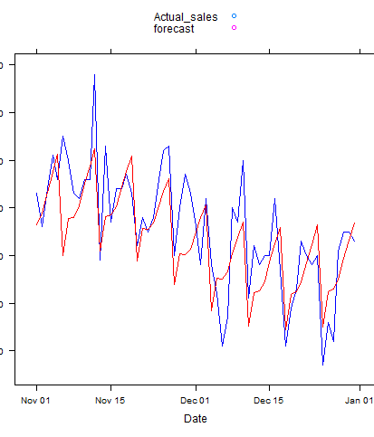
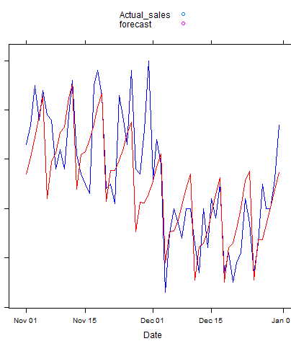
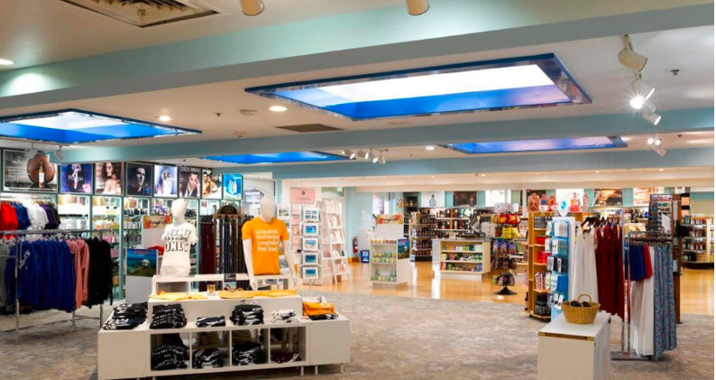
OPTIMIZING INVENTORY
Inventory can be Optimized by Estimating the Demand of item for future Period
Demand Calculation done by forecasting item sales
We are doing forecasting for each stores across all items for future period.
Fig gives you a plot of Actual and forecasting for Sixty days window

Slide 11
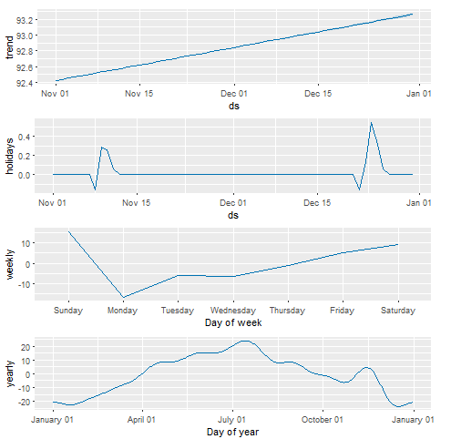
FACTORS INFLUENCING FORECASTING
Trend
Seasonality
Holiday Factor

Slide 12
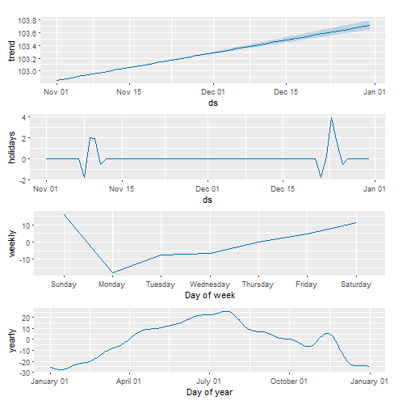
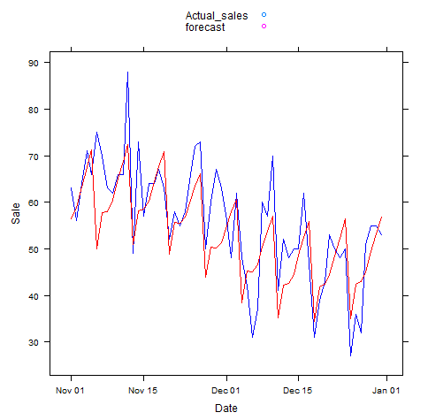
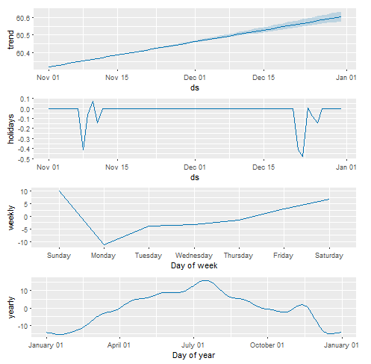
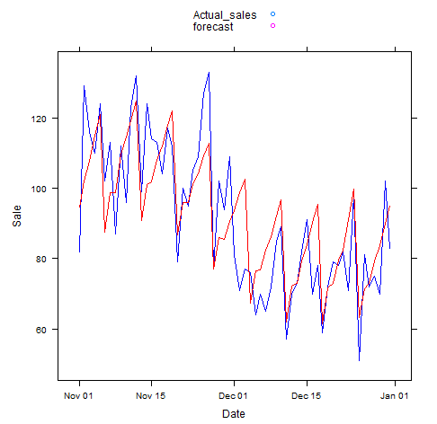
Captures the holiday effect of November month
Fig shown on the right is the plot of multiple factors and the plot of Actual and forecasted output of two different item id 6 and 12 of two different store id 1 and 2.
We have Captured the trend, Holiday events and seasonality across the period.
Figure gives you the view of how these factors on the left affecting the pattern of the forecasting on the right.
Captures the negative effect of November month in another store

Slide 13
Understanding the impact of external variables
How does external variables like weather, macro economic variables etc. impact sales ?.
Let’s understand that with a case on a store containing multiple departments and how a single department gets affected by this factor.

Slide 14
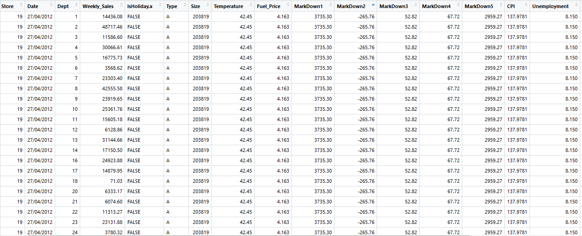

Data collection mechanism
What are the macro economic factors useful for retailers?
How can I understand the impact of political unstability via data factors?
How should I prepare to capture this data ?

Slide 15
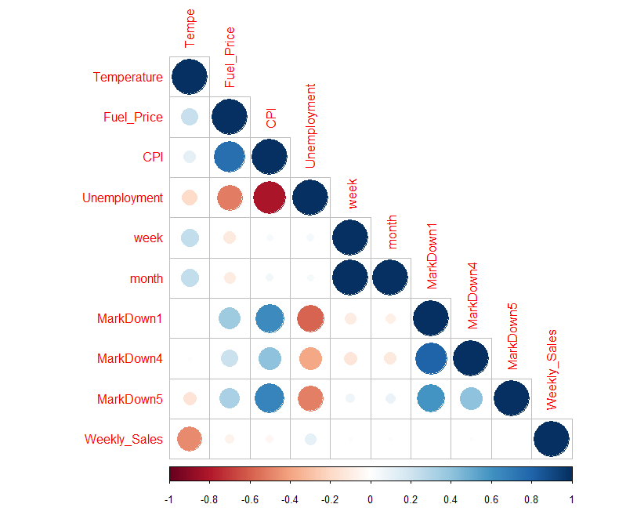
General global factors influencing forecasting
Weather factor
Macro Economic variables

Slide 16
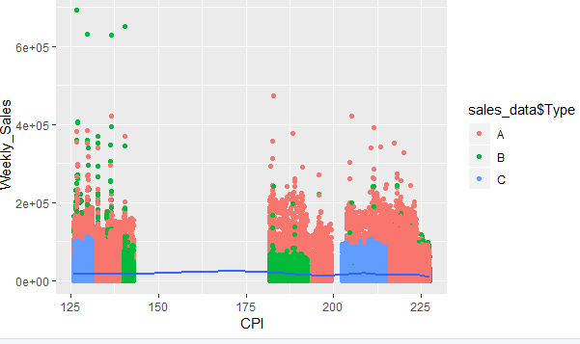
Consumer Price Index influence across stores
Store type A sales are not affected much by CPI. Typically Type A stores are bigger in size and have essential commodities

Slide 17
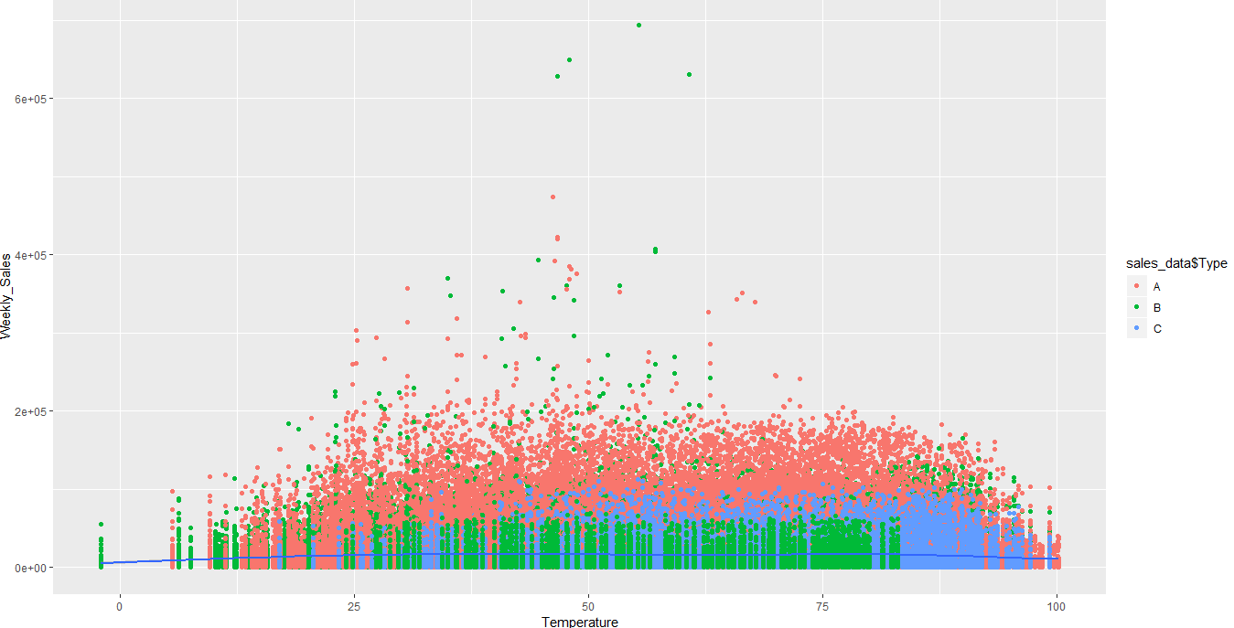
Temperature influence across stores
Minimal influence

Slide 18
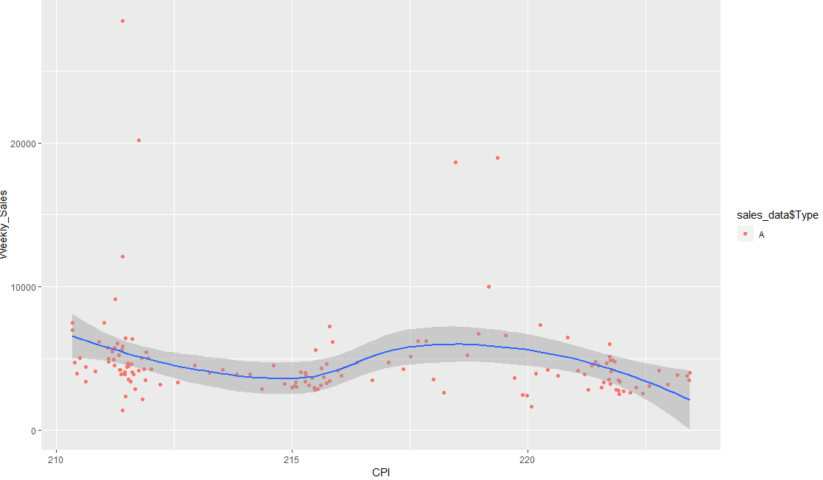
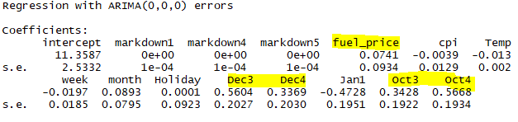
Sample analysis - Single department of store ‘A’
Fuel price plays a factor in forecasting sales for this department and store
CPI influence in Store type of ‘A’
Christmas eve and October last weeks have impact in sales in this department

Slide 19
Insights for inventory management
Department 1 needs to plan for optimal stocking in Christmas eve and October last month.
Safety stocks needs to understand the lead time from supplier apart from forecast to derive at the value.
Overall external variables needs to be studies at granular level rather than at higher level.

Slide 20
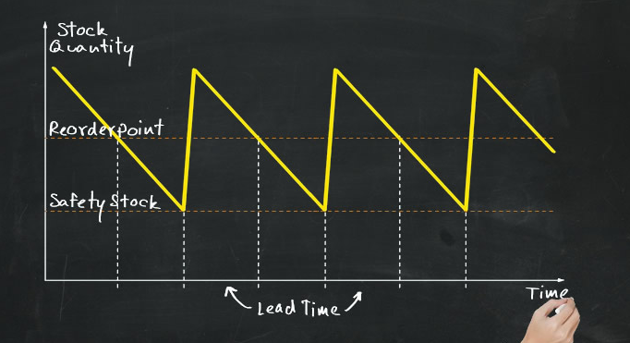
FACTORS THAT INFLUENCE FOR OPTIMIZING INVENTORY
DEMAND ESTIMATION
LEAD TIME
SAFETY STOCK
RE-ORDER POINT(ROP)

Slide 21
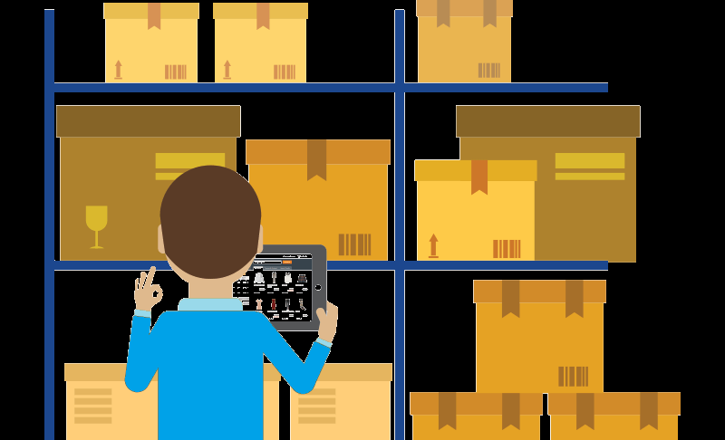
DEMAND ESTIMATION: Demand for the future Periods, which can be calculated through Forecasting.
Lead Time: It is a time interval between placing an order and receiving it.
Safety Stock: It is most important factor to maintain the good service level, that makes inventory to prevent from stock-out and back order situation.
ROP: Its is to find an optimal point to open the purchase order by having lead time and Safety Stock into consideration.

Slide 22
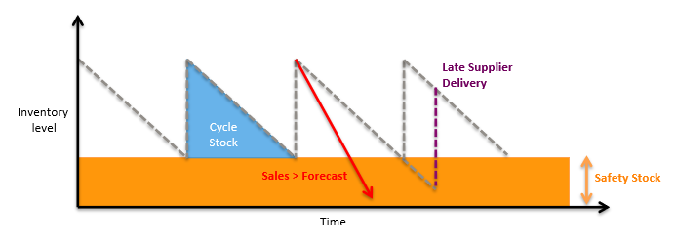
Why Safety Stock?
Offset errors due to forecast
Maintain service level

Slide 23
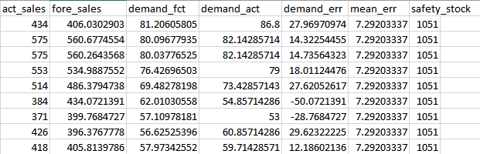

Calculating Safety Stock
Simple Safety Stock Calculation with lead time, order cycle and forecast period are same.
$ss=z∗σ_{d}$
$Z→Z−Score,Service factor of required service level$
$σ_{d}→Standard deviation of demand$
Safety Stock Formula including both demand and Varying lead time
$SS=Z∗σ_{d}∗\sqrt{L}T+ε_{0}$
$Z→Z−Score,Service factor of required service level$
$σ_{d}→Standard deviation of demand$
$LT→Average Lead Time$
$ε_{0}→Forecast Error$

Slide 24
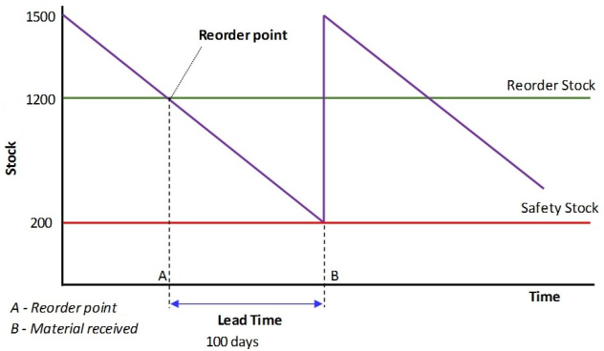

RE-ORDER POINT(ROP)
It is a process most commonly used in supply chain and logistic which is when stock is always ordered when it falls below a certain level, typically below the specified safety stock level.
$$ROP=D∗LT+SS$$
$D→Avg Demand$ in lead time
$LT→LeadTime$
SS -> Safety Stock

Slide 25
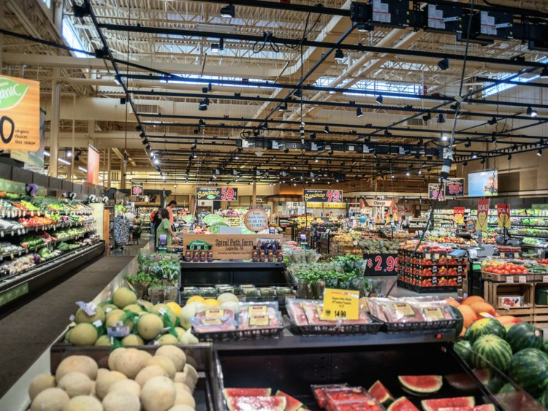



Solution benefits
INVENTORY OPTIMIZATION
Proper inventory tracking at SKU level.
Reduction of excess inventory.
Reduction of stock-outs scenario.
OPERATIONAL EFFICIENCY
Estimate safety stock.
Proper identification of order cycle and reorder quantities.
COST OPTIMIZATION
Lower Holding cost.
Lower Spoilage discount.

Slide 26
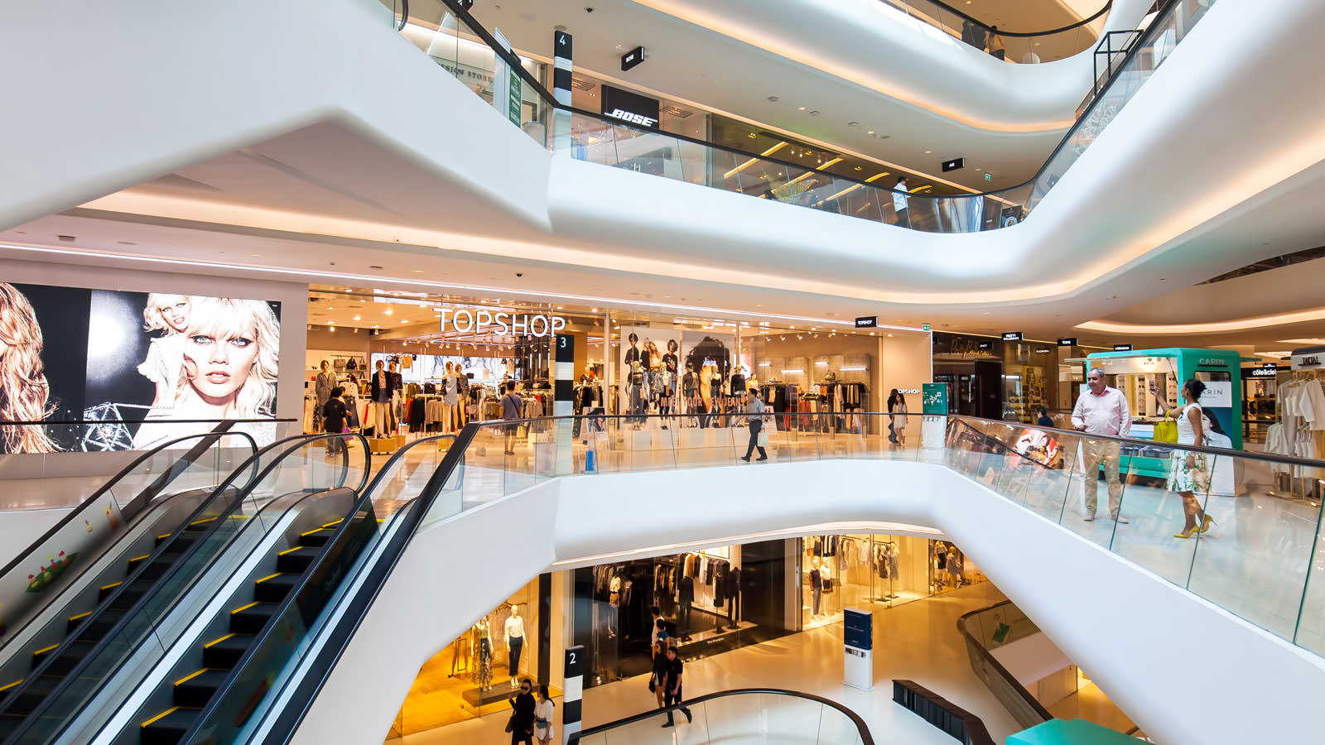
Customer Propensity Model
Personalized customer marketing
Customer data at retail outlet level
Operates in non-contractual settings

Slide 27
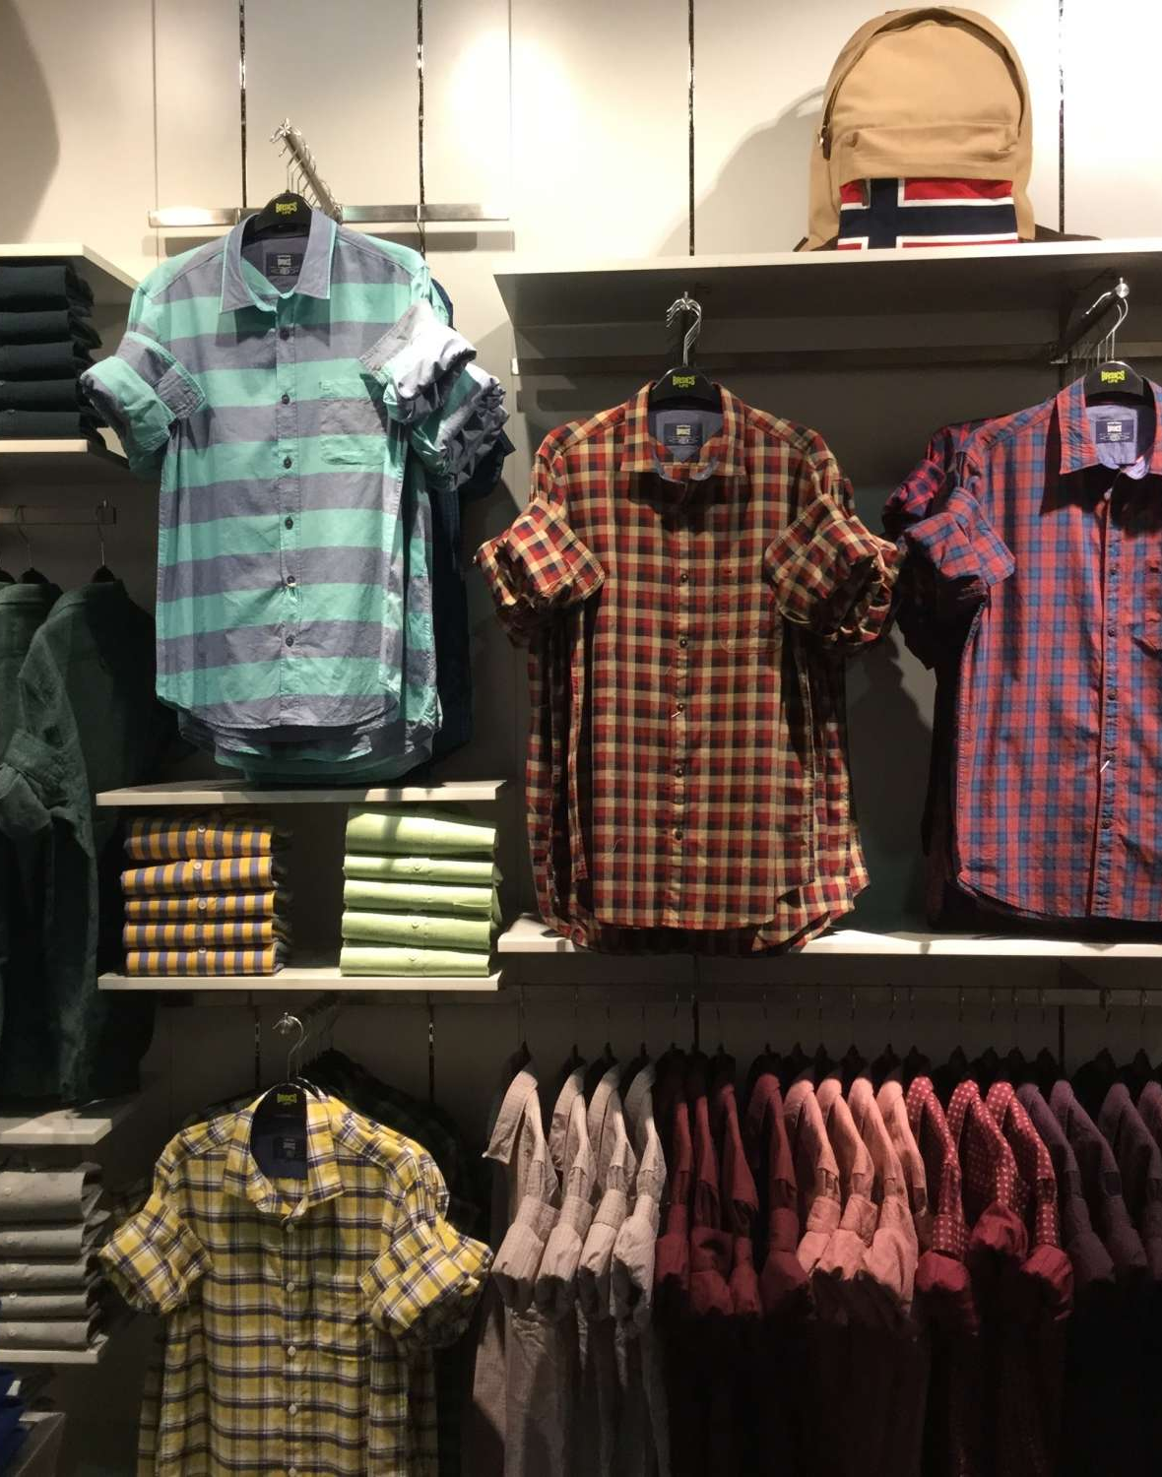
Customer Propensity model answers
Who are my probable customers who will visit my store in the next ‘X’ days ?.
How can I get my targets for the next promotion campaigns ?.
Who are my high-profile customers and what categories they buy in general ?.

Slide 28
THANKS

